Slide 1
Device Shifts
March/April

Slide 2
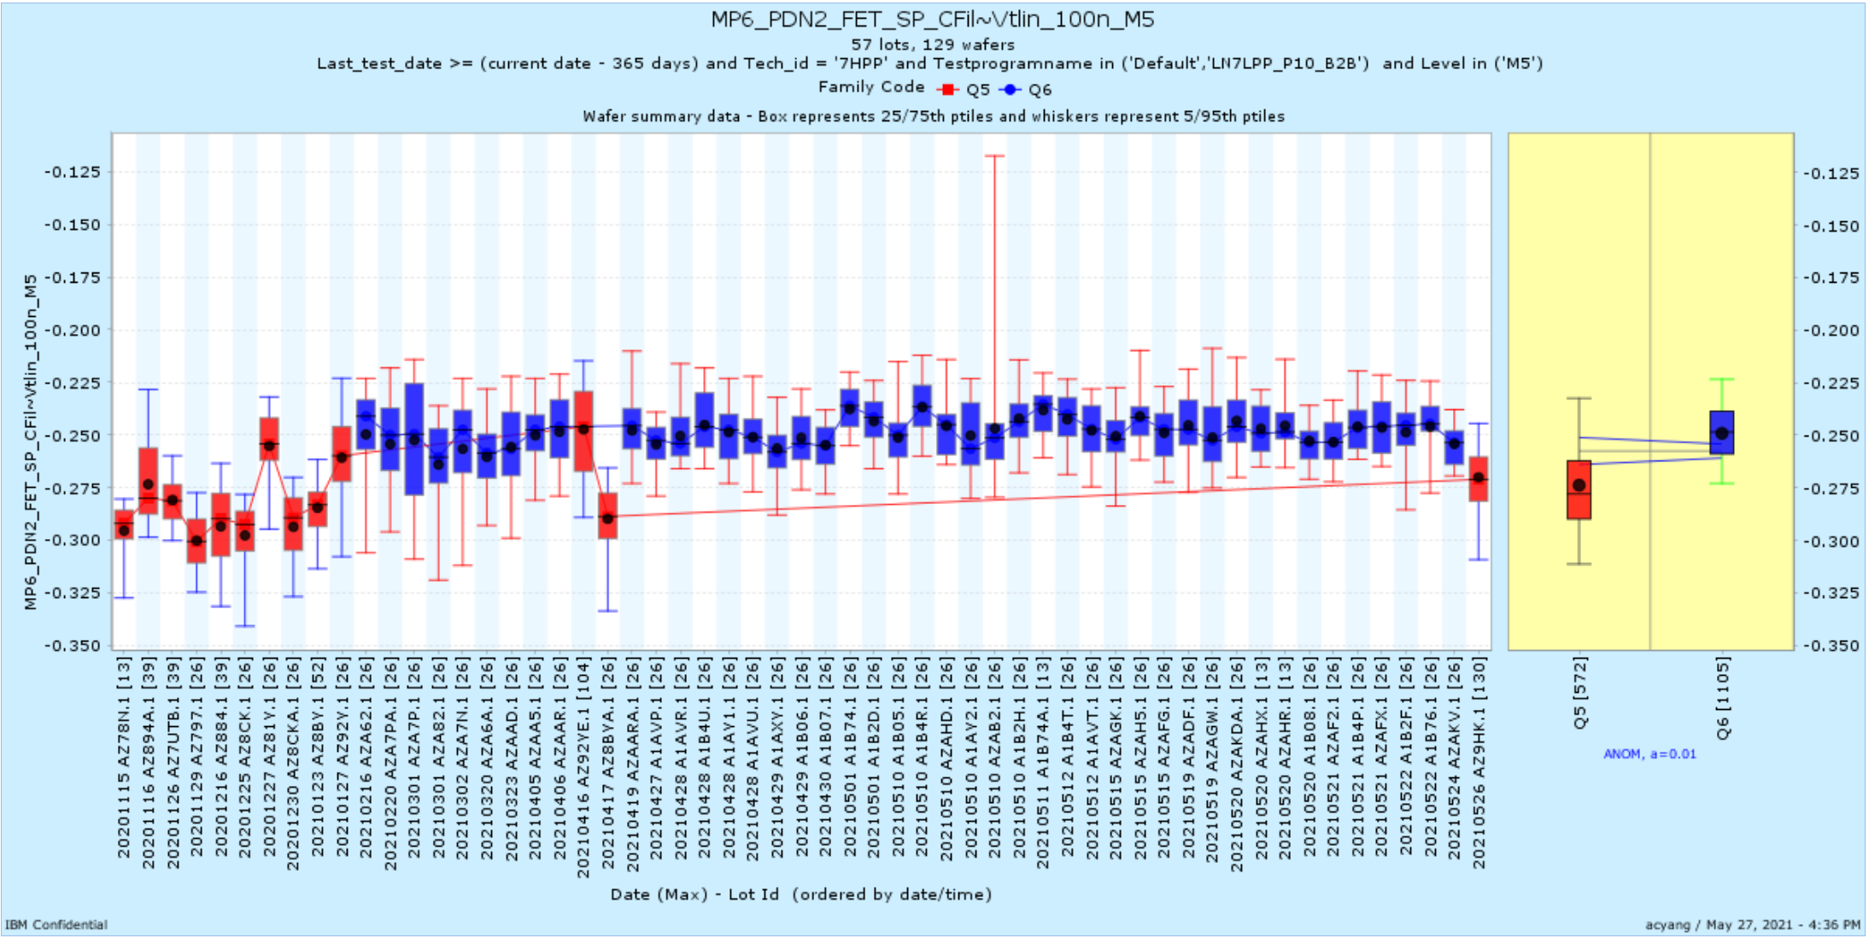
MP6_PDN2_FET_SP_CFil~Vtlin_100n_M5 | AZAA5 | 4/5/21 | Device
MP6_PDN2_FET_SP_EGHi~Vtsat_100n_M5 | AZAA5 | 4/5/21 | Device

Slide 3
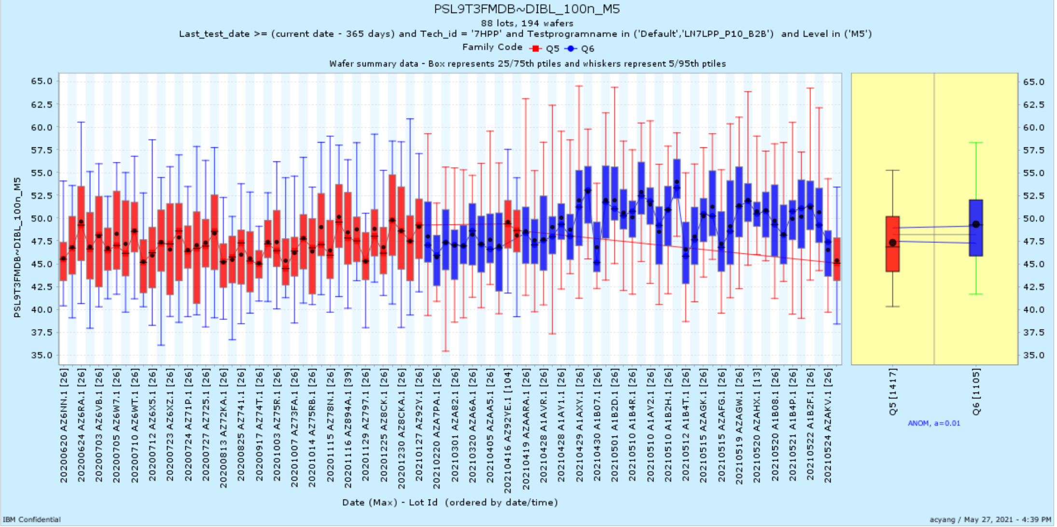
MP6_PDN2_FET_SP_9T9T~DIBL_100n_M5 | A1AY1 | 4/28/21 | Device
MP6_PDN2_FET_SP_EGHi~DIBL_100n_M5 | A1AY1 | 4/28/21 | Device
MP6_PDN2_FET_SP_Fil2~DIBL_100n_M5 | A1AY1 | 4/28/21 | Device
MP6_PDN2_FET_SP_Fil3~DIBL_100n_M5 | A1AY1 | 4/28/21 | Device
MP6_PDN2_FET_SP_VPNP~DIBL_100n_M5 | A1AY1 | 4/28/21 | Device
NSL9T4FMDBNF13CSA~Vtlin_100n_M5 | A1AVR | 4/28/21 | Device
PSL9T3FMDB~DIBL_100n_M5 | A1AVR | 4/28/21 | Device
PSL9T4FMDBNF1~DIBL_100n_M5 | A1AVR | 4/28/21 | Device
PSL825T4FMDBNF1~DIBL_100n_M5 | A1AVR | 4/28/21 | Device
PSL9T4FMDBNF11CSA~DIBL_100n_M5 | A1AVR | 4/28/21 | Device
PSL9T4FMDBNF12CSA~DIBL_100n_M5 | A1AVR | 4/28/21 | Device
PSL9T4FMDBNF13CSA~DIBL_100n_M5 | A1AVR | 4/28/21 | Device
PSL9T4FMDBNF154~DIBL_100n_M5 | A1AVR | 4/28/21 | Device
PSL825T4FMDBNF154~DIBL_100n_M5 | A1AVR | 4/28/21 | Device
PSL9T2FMDBNF1~DIBL_100n_M5 | A1AVR | 4/28/21 | Device
PSLREL4FMDBNF1~DIBL_100n_M5 | A1AVR | 4/28/21 | Device
PSLUNI4FMDB~DIBL_100n_M5 | A1AVR | 4/28/21 | Device
PSL9T4FMDBREF~DIBL_100n_M5 | A1AVR | 4/28/21 | Device

Slide 4
FEOLMOL_HOL Shifts
March/April

Slide 5
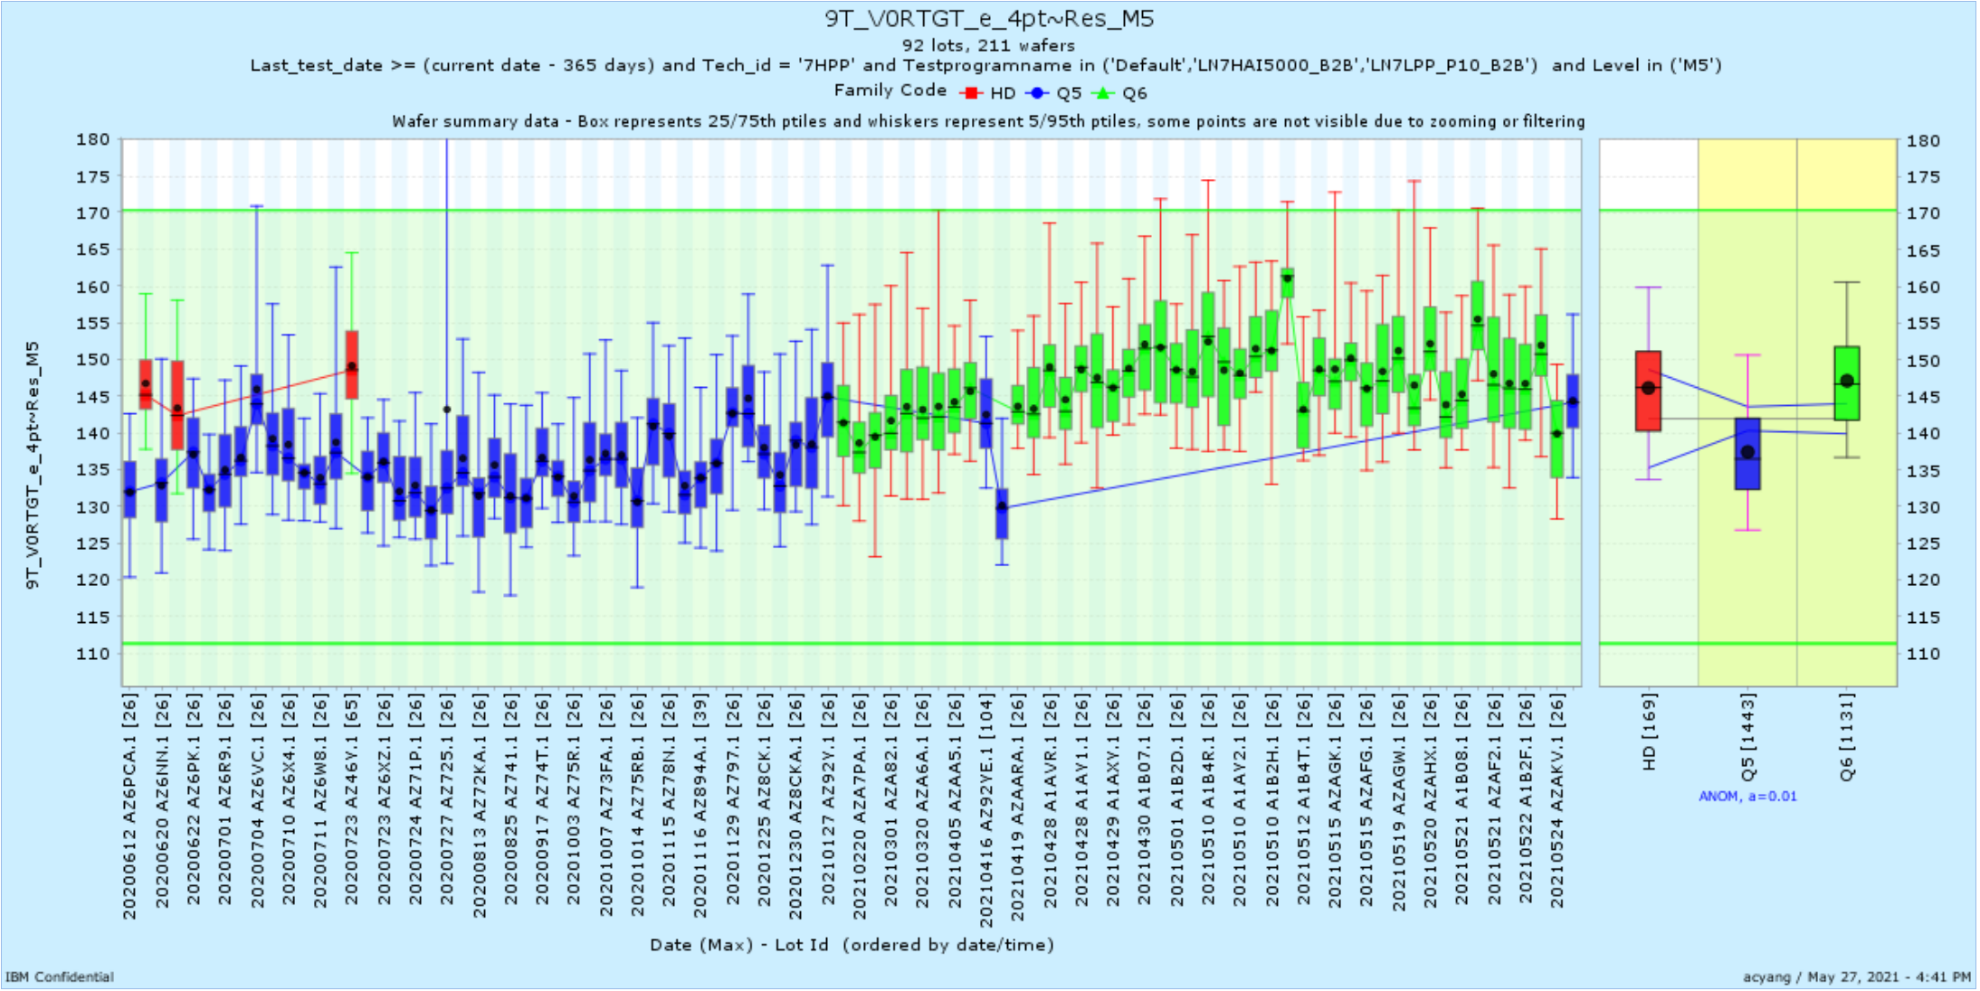
9T_V0RTGT_e_4pt~Res_M5 | AZA7N | 3/2/21 | FEOLMOL_HOL
9T_V0V1PWR_4pt~Res_M5 | AZA7N | 3/2/21 | FEOLMOL_HOL

Slide 6
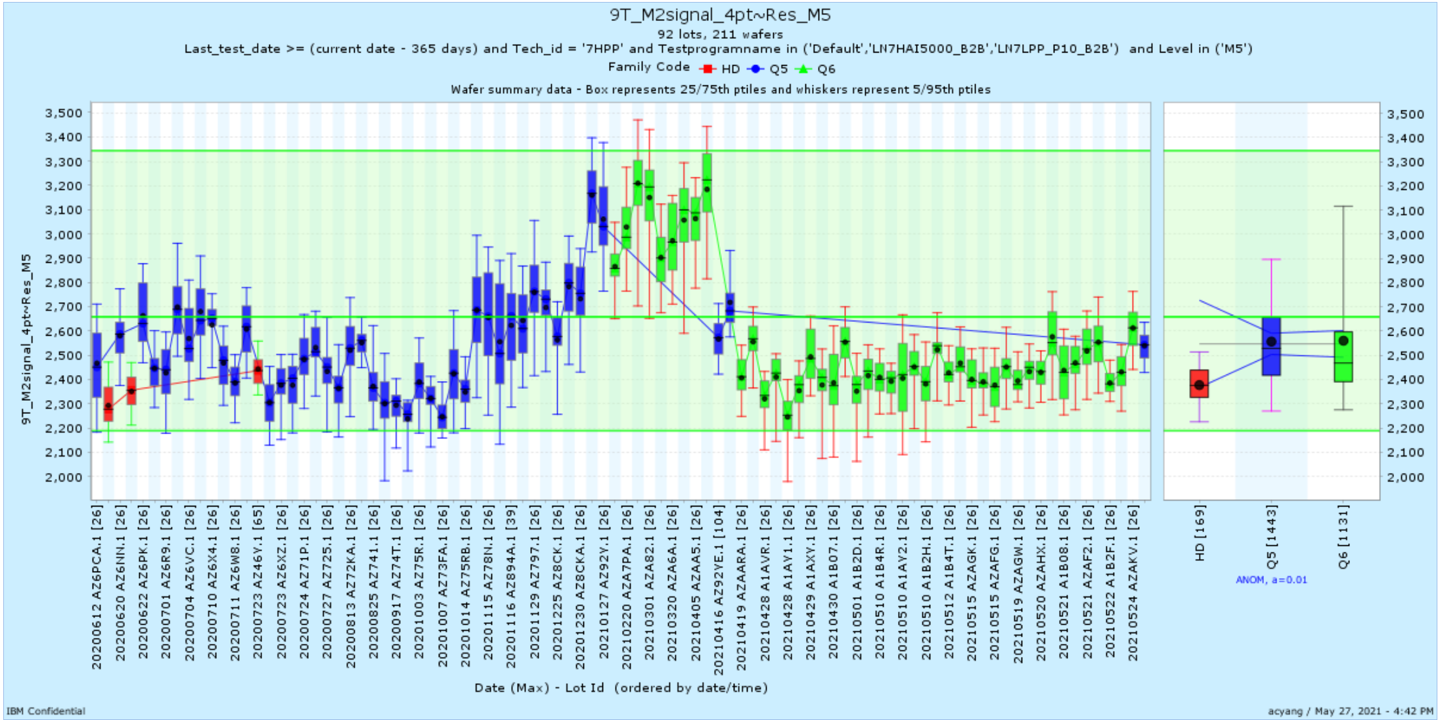
9T_M2signal_4pt~Res_M5 | A1AVP | 4/27/21 | FEOLMOL_HOL

Slide 7
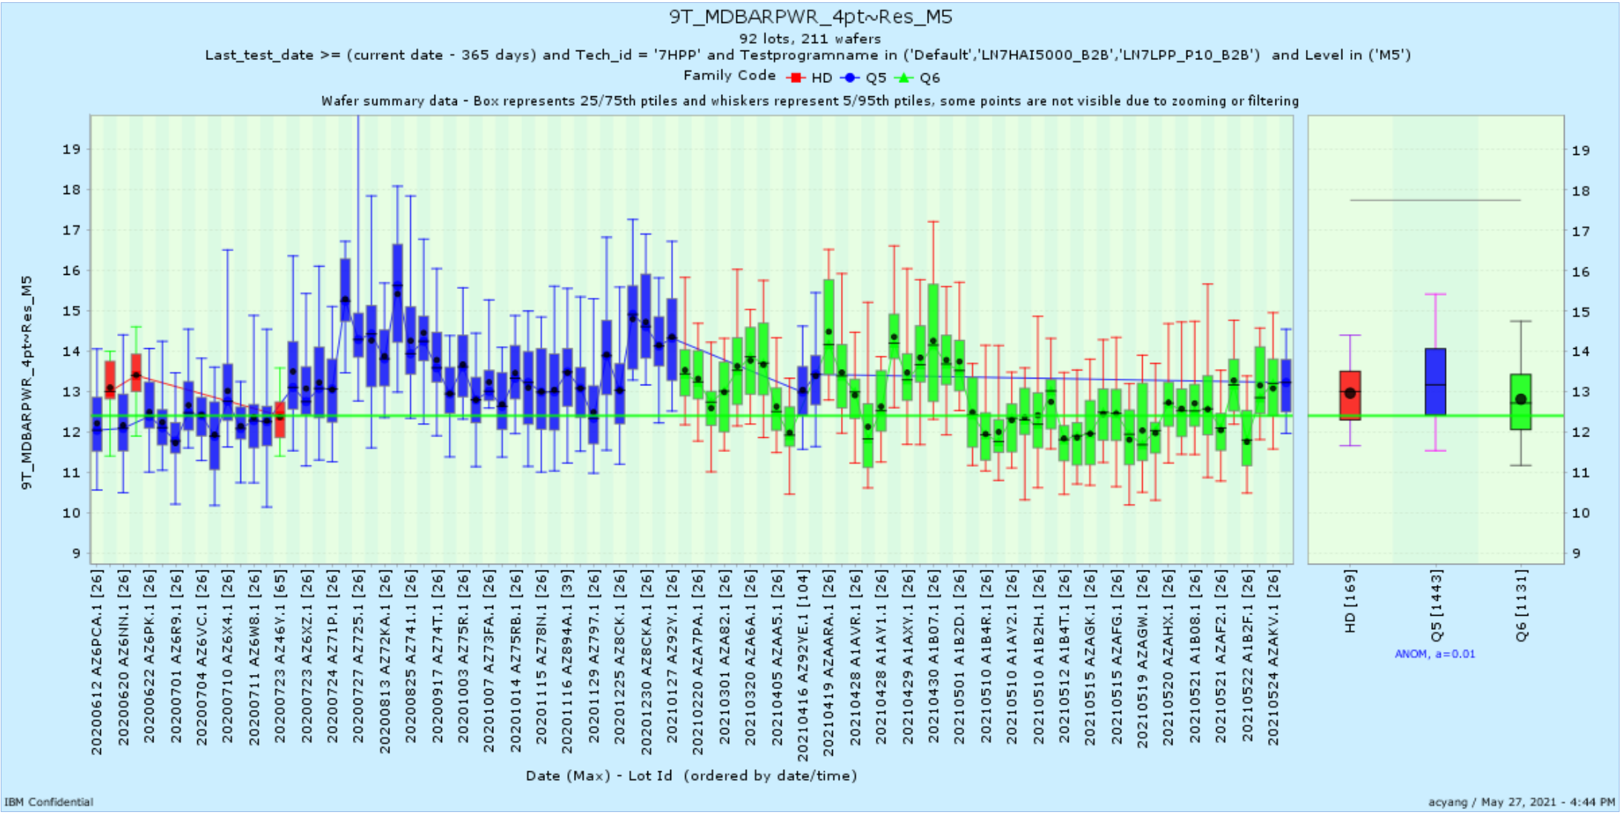
9T_MDBARPWR_4pt~Res_M5 | A1AY2 | 5/10/21 | FEOLMOL_HOL

Slide 8
Reliability Shifts
March/April

Slide 9
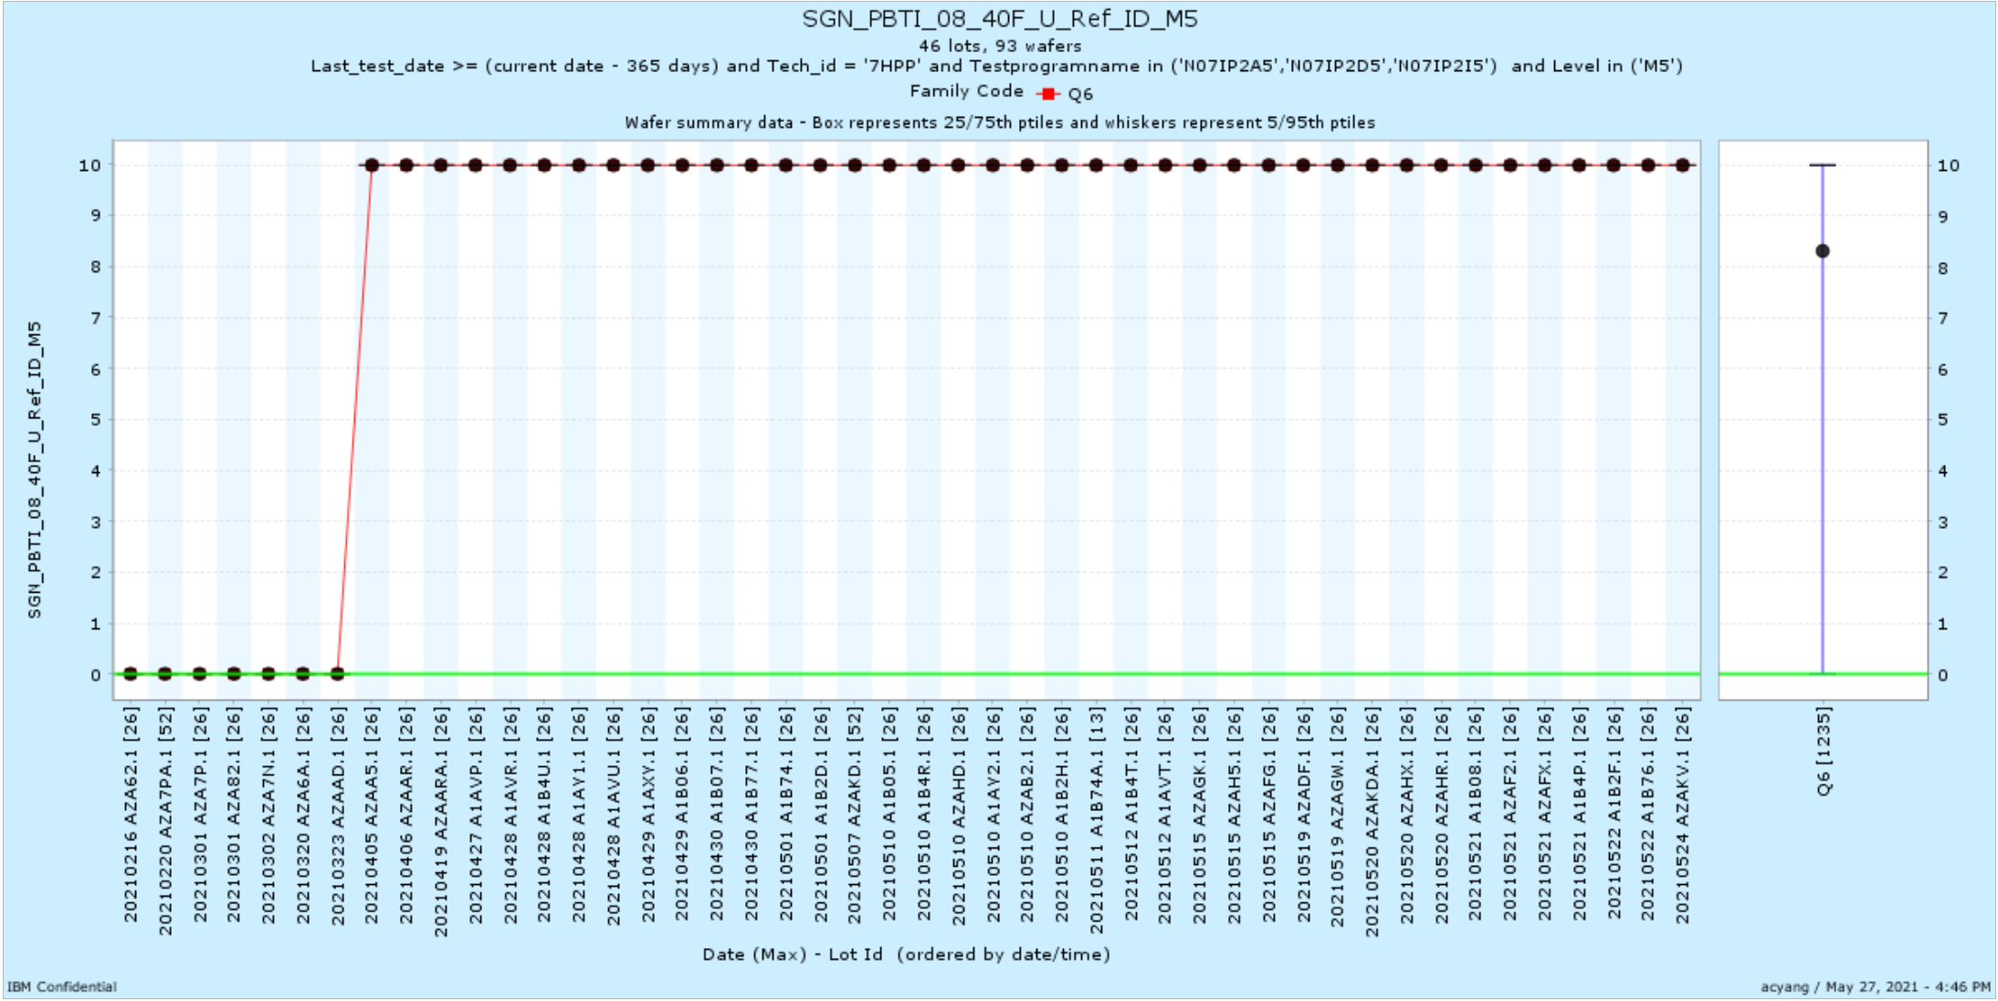
SGN_PBTI_08_40F_U_Ref_ID_M5 | AZAAD | 3/23/21 | REL
SGP_NBTI_08_40F_U_Ref_ID_M5 | AZAAD | 3/23/21 | REL

Slide 10
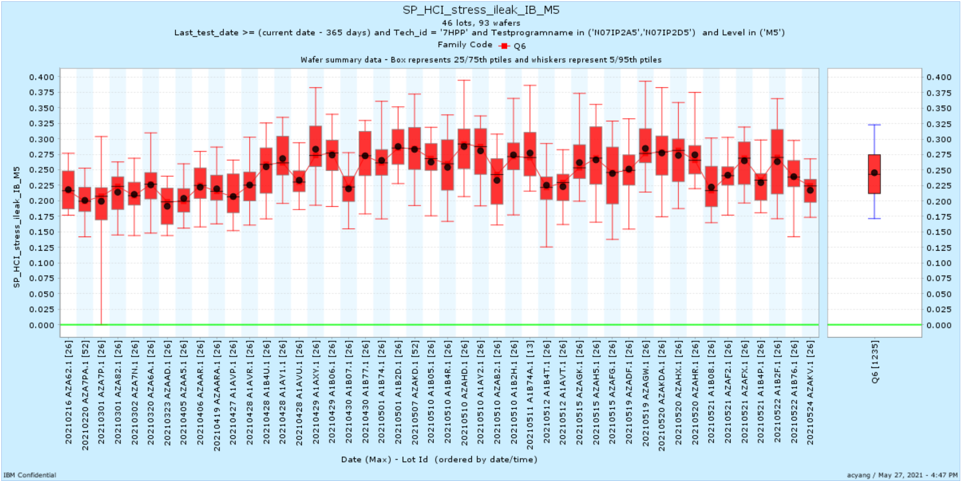
SP_HCI_stress_ileak_IB_M5 | A1AVU | 4/28/21 | REL
SP_HCI_stress_ileak_IS_M5 | A1AVU | 4/28/21 | REL

Slide 11
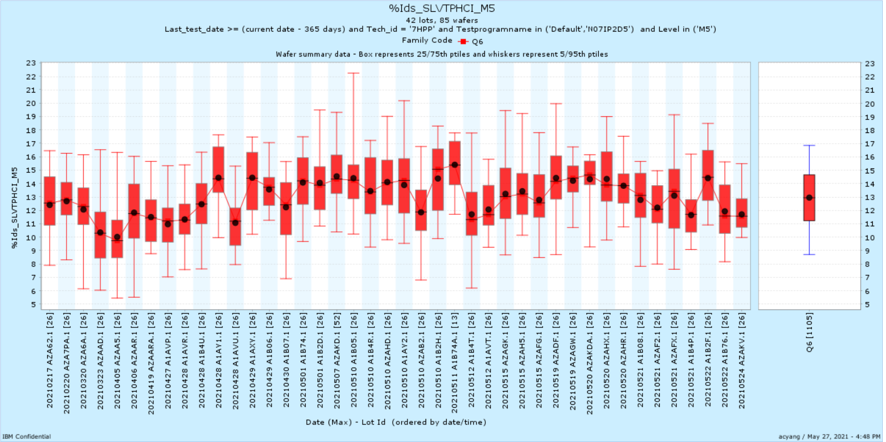
%Ids_SLVTPHCI_M5 | A1AVU | 4/28/21 | REL

Slide 12
SRAM Shifts
March/April

Slide 13
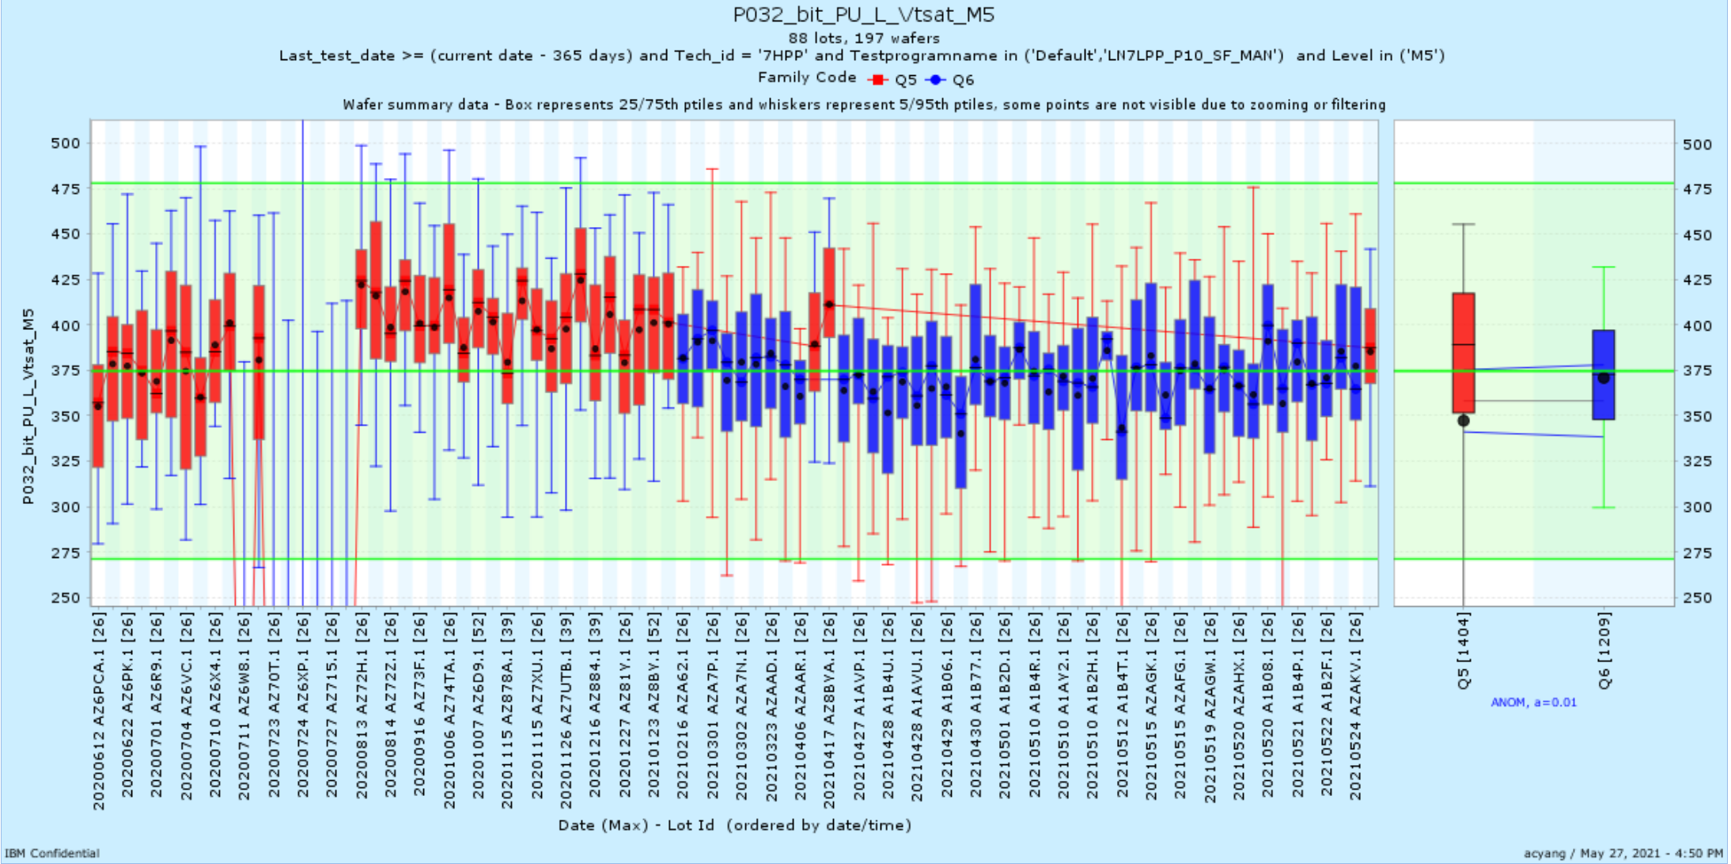
P032_bit_PU_L_Vtsat_M5 | AZA7N | 3/2/21 | SRAM
P032_bit_PU_R_Vtsat_M5 | AZA7N | 3/2/21 | SRAM
P032_bit_PU_L_Vtlin_M5 | AZA7N | 3/2/21 | SRAM
P032_bit_PU_R_Vtlin_M5 | AZA7N | 3/2/21 | SRAM
P032_bit_PU_R_Idsat_M5 | AZA7N | 3/2/21 | SRAM
P032_FET_PU_Vtsat_M5 | AZA7N | 3/2/21 | SRAM
P032_FET_PU_Vtlin_M5 | AZA7N | 3/2/21 | SRAM
P032_FET_PD_Idoff_M5 | AZA7N | 3/2/21 | SRAM
P032_FET_PG_Idoff_M5 | AZA7N | 3/2/21 | SRAM
P032_WRM_M5 | AZA7N | 3/2/21 | SRAM
PL032S_bit_PG_L_Vtsat_M5 | AZA7N | 3/2/21 | SRAM
PL032S_bit_PU_R_Vtsat_M5 | AZA7N | 3/2/21 | SRAM
PL032S_bit_PU_R_Vtlin_M5 | AZA7N | 3/2/21 | SRAM
PL032S_bit_PU_R_Idsat_M5 | AZA7N | 3/2/21 | SRAM
PL032S_FET_PU_Vtsat_M5 | AZA7N | 3/2/21 | SRAM
PL032S_FET_PU_Vtlin_M5 | AZA7N | 3/2/21 | SRAM
PL032S_FET_PG_Idoff_M5 | AZA7N | 3/2/21 | SRAM
TPLL053_FET_RPG_Vtsat_M5 | AZA7N | 3/2/21 | SRAM
TPLL053_FET_RPG_Idlin_M5 | AZA7N | 3/2/21 | SRAM
TPLL053_FET_RPG_Idoff_M5 | AZA7N | 3/2/21 | SRAM
P032_FET_PG_Iginv_M5 | AZA7N | 3/2/21 | SRAM
P032_FET_PU_Iginv_M5 | AZA7N | 3/2/21 | SRAM
PL032S_FET_PG_Iginv_M5 | AZA7N | 3/2/21 | SRAM
PL032S_ISB_M5 | AZA7N | 3/2/21 | SRAM
TPLL053_ISB_M5 | AZA7N | 3/2/21 | SRAM

Slide 14
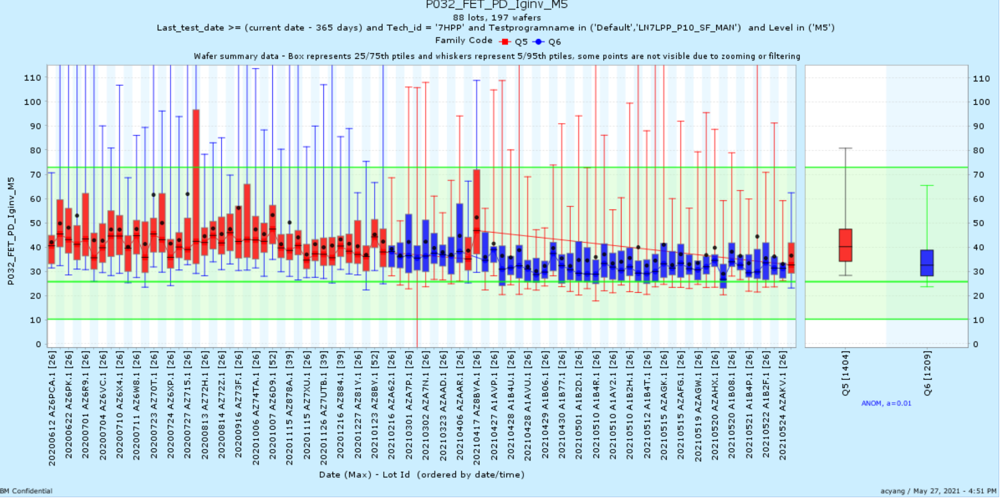
P032_FET_PD_Iginv_M5 | A1AVP | 4/27/21 | SRAM
PL032S_FET_PD_Iginv_M5 | A1AVP | 4/27/21 | SRAM
TPLL053_FET_RPG_Iginv_M5 | A1AVP | 4/27/21 | SRAM

Slide 15
BEOL Shifts
March/April

Slide 16
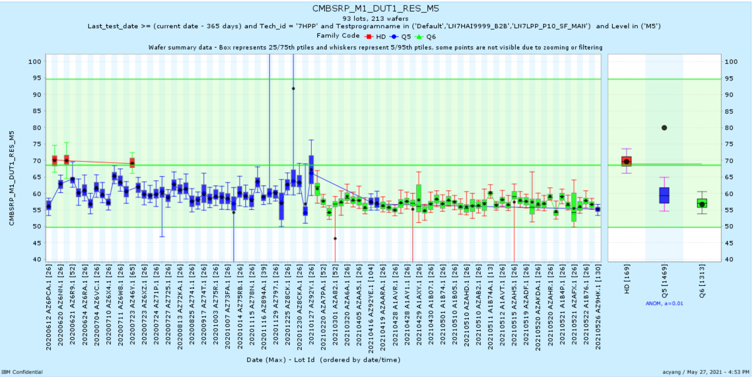
CMBSRP_M1_DUT1_RES_M5 | AZA7N | 3/2/21 | BEOL
CMBSRP_M1_DUT1_RES_M5 | AZA7N | 3/2/21 | BEOL
CMBSRP_M1_DUT1_RES_M5 | AZA7N | 3/2/21 | BEOL
CMBSRP_M1_DUT1_RES_M5 | AZA7N | 3/2/21 | BEOL
CMBSRP_M1_DUT2_RES_M5 | AZA7N | 3/2/21 | BEOL
CMBSRP_M1_DUT2_RES_M5 | AZA7N | 3/2/21 | BEOL
CMBSRP_M1_DUT2_RES_M5 | AZA7N | 3/2/21 | BEOL
CMBSRP_M1_DUT2_RES_M5 | AZA7N | 3/2/21 | BEOL
METAL_KELVIN_M3_M5 | AZA7N | 3/2/21 | BEOL

Slide 17
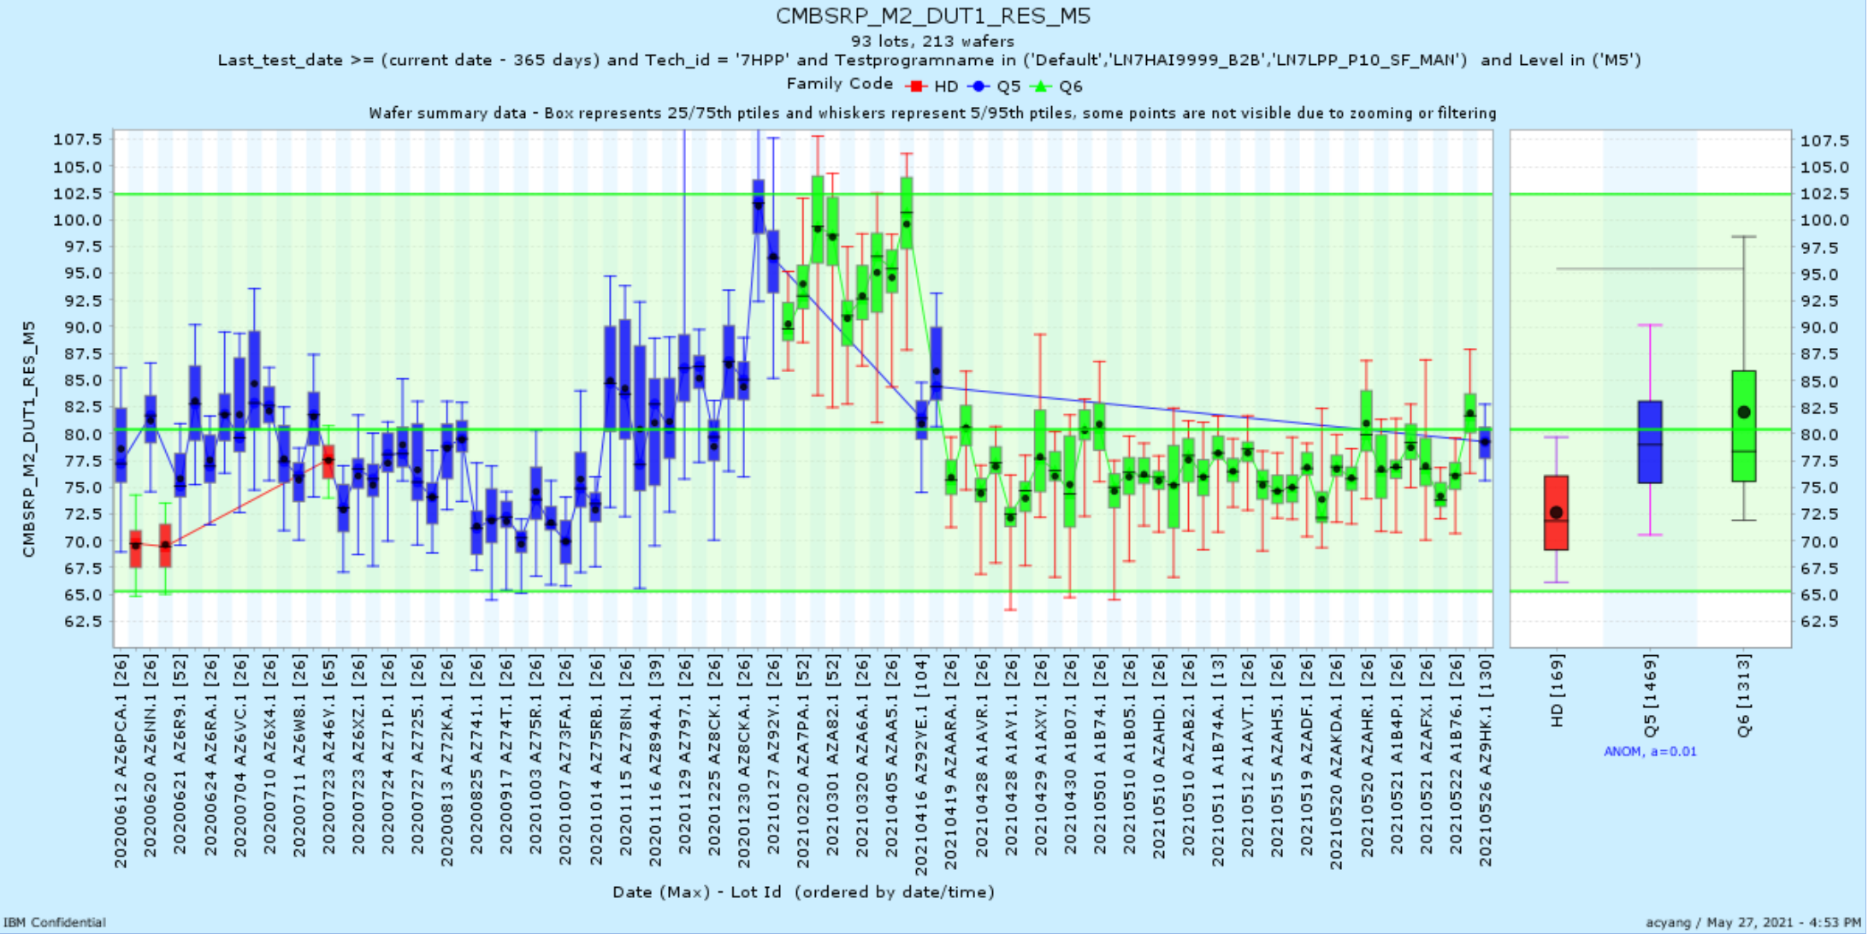
CMBSRP_M2_DUT1_RES_M5 | A1AVP | 4/27/21 | BEOL
CMBSRP_M2_DUT1_RES_M5 | A1AVP | 4/27/21 | BEOL
CMBSRP_M2_DUT1_RES_M5 | A1AVP | 4/27/21 | BEOL
CMBSRP_M2_DUT1_RES_M5 | A1AVP | 4/27/21 | BEOL
CMBSRP_M2_DUT2_RES_M5 | A1AVP | 4/27/21 | BEOL
CMBSRP_M2_DUT2_RES_M5 | A1AVP | 4/27/21 | BEOL
CMBSRP_M2_DUT2_RES_M5 | A1AVP | 4/27/21 | BEOL
CMBSRP_M2_DUT2_RES_M5 | A1AVP | 4/27/21 | BEOL
METAL_KELVIN_M2_M5 | A1AVP | 4/27/21 | BEOL

